Slide 1
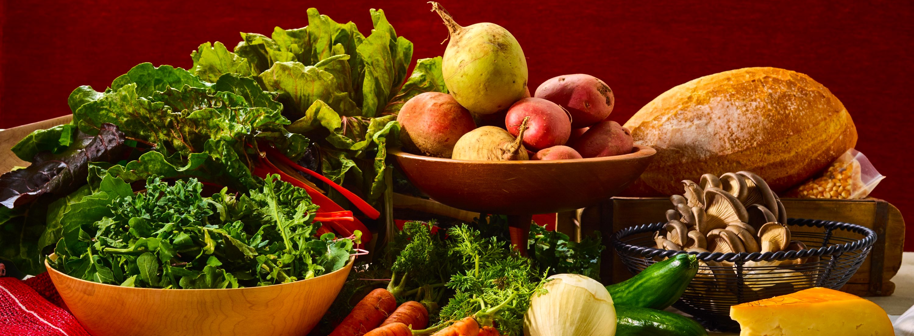
May 2023
Nutrition
NEWSLETTER
Inside:
Brought to you by:
Tahini Lemon Kale Salad by Judy Doherty, MPS, PC II
Turmeric Chicken Noodle Soup, by Judy Doherty, MPS, PC II
Shop With 3, by Victoria Shanta Retelny, RDN
Functional Ingredient: Collagen, By Lynn Grieger, RDN, CDCES, CHWC, CPT
Fat Math, by Judy Doherty, MPS, PCII
6 Tips to Lower Calories, by Lisa Andrews, MEd, RD, LD
Highly Palatable Food Strikes Again, by Lisa Andrews, MEd, RD, LD
High Fat Diet May Lead to Overeating, by Lisa Andrews, MEd, RD, LD
Tips To Reduce Ultra-Processed Foods, by Lisa Andrews, MEd, RDN

Slide 2
Tahini Lemon Kale Salad
Ingredients:
Salad:
3 cups chopped purple kale
3 cups curly green kale
1 lemon
1 cup shredded or sliced carrots
1/4 cup sliced green onion
1 avocado, peeled and cubed
1 tablespoon sesame seeds
1 sprig mint
Dressing:
3 tablespoons tahini paste
1/4 cup lemon juice
1 tablespoon honey
1 tablespoon rice vinegar
Directions:
Place the kale in a bowl. Add the lemon juice and massage the leaves together with the lemon juice.
Mix the dressing and pour over the kale. Add the mint leaves. Toss the greens together with the dressing. Add the rest of the ingredients and toss. Place on plates.
Optional garnish; edible flowers or colorful sprouts.
Nutrition Facts:
Serves 4. Each 1 cup serving: 236 calories, 16 g fat, 2.25 g saturated fat, 0 mg cholesterol, 85 mg sodium, 23 g carbohydrates, 10 g fiber, 13 g carbohydrate, 8 g sugar, 7 g protein

Slide 3
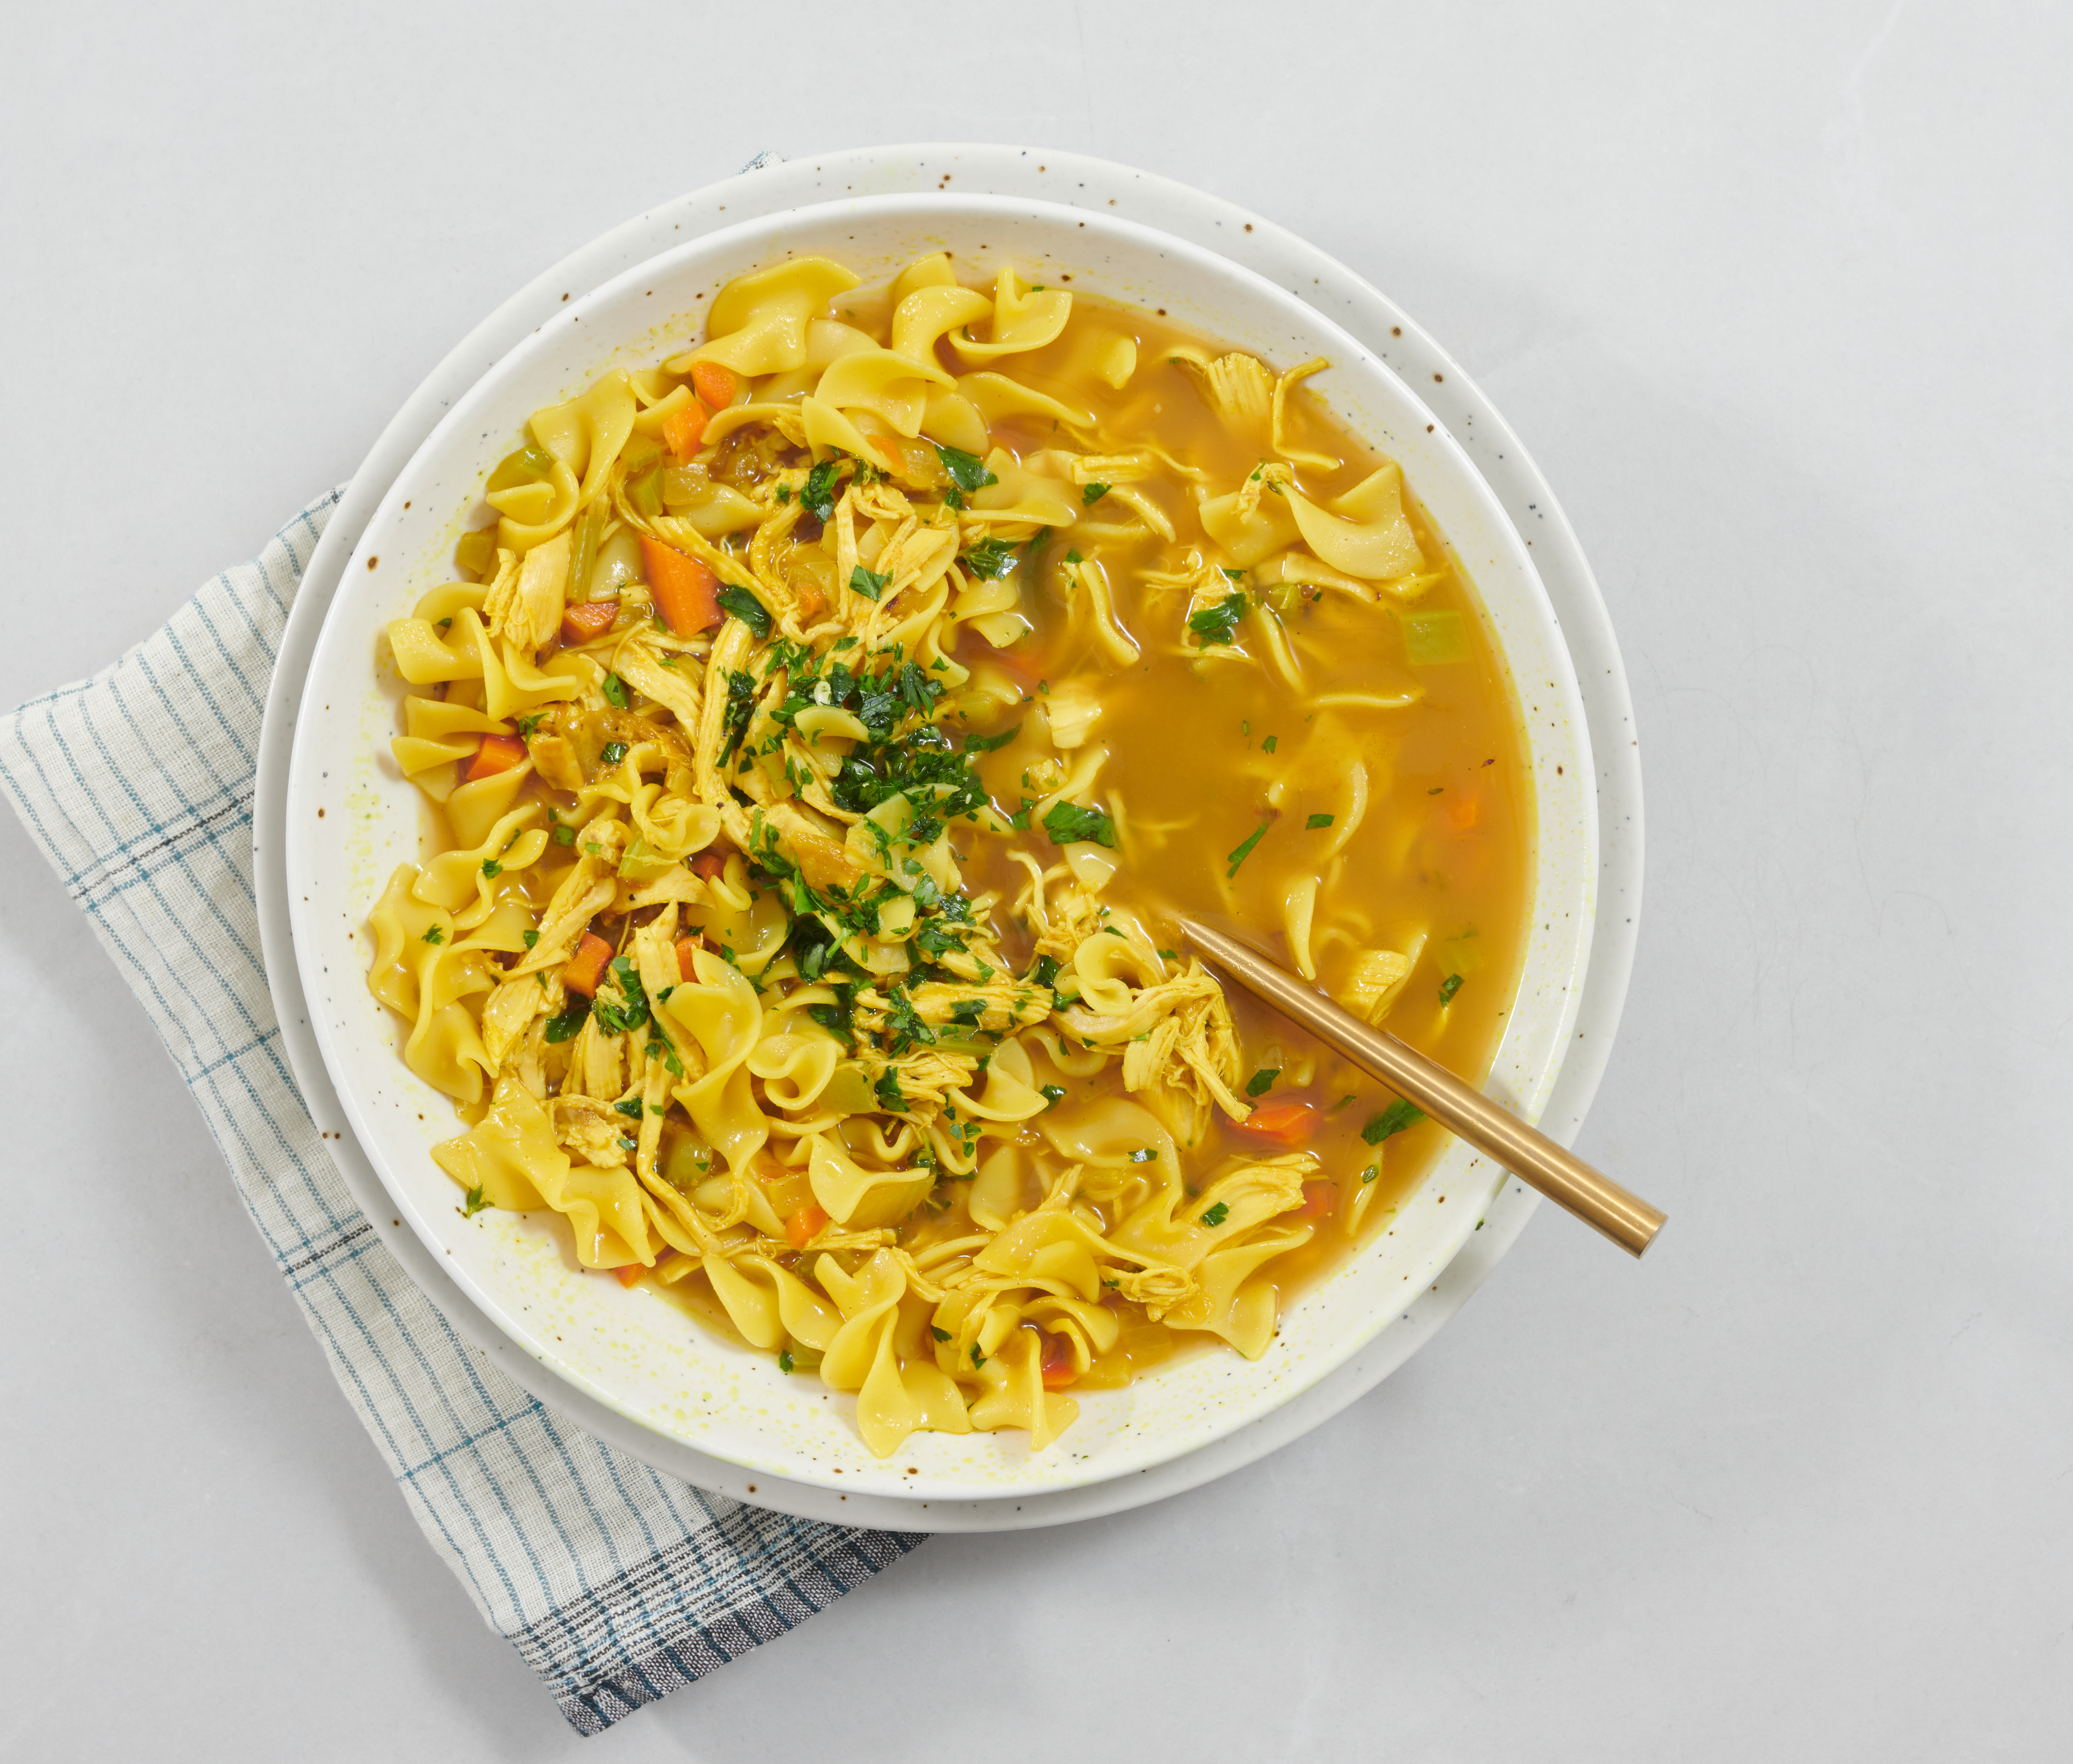
Turmeric Chicken Noodle Soup
This delicious soup has a beautiful color from the turmeric.
Ingredients:
1 tsp olive oil
1/2 cup sliced carrots
1/2 cup chopped onions
1/2 cup chopped celery
1 tsp thyme
1 tsp turmeric
1 tsp garlic powder
4 cups water
4 cups chicken broth
8 ounces wide noodles
1 cup shredded rotisserie chicken
1/4 cup fresh chopped parsley
Directions:
Saute the carrots, celery, and onions in the olive oil. Add the seasonings. Cook for 3 minutes or until the onions are translucent.
Add the water and noodles. Cook for 10 minutes until the noodles are al dente or almost tender. Add the chicken and cook for 5 more minutes or until everything is heated through and the noodles are tender.
Top with parsley and serve hot.
Serves 6. Each 1 cup serving: 248 calories, 6 g fat, 1.5 g saturated fat, 72 mg cholesterol, 750 mg sodium, 30 g carbohydrate, 2 g fiber, 17 g protein.

Slide 4
Shopping: 3 Simple Changes
Victoria Shanta Retelny, RD, has a great strategy for shopping when you don’t have time to plan meals or make a list - it is what she calls 3 simple changes that can make a big difference:
1. Monitor your salt intake.
Check labels for sodium and shoot for nothing over 480 – 500 mg of sodium per serving.
When you add salt to home-cooked meals or at restaurants, taste the food first – it may not need salt.
2. Buy drinks without calories.
Liquid calories account for a big part of the average American’s caloric intake.
Not only does it contribute to overweight and obesity, but it displaces other nutritional calories.
Here are some ways to make lower-calorie beverage choices:
Choose skim/low-fat lattes versus drinks with cream and whipped cream
Drink mineral water with a twist of lemon, lime, or orange instead of regular or diet sodas.
Incorporate unsweetened tea into your daily regimen – as it’s a great low-calorie, nutritious way to begin and end the day (as long as you don’t add a lot of cream and sugar!)
3. Eat less meat and more plants.
Not only will you be helping to save our planet by eating more plants, but people that eat more vegetables typically get more fiber, potassium, and anti-oxidants in their diets when they forgo animal products.
Designate weekly meatless days, experiment with roasting different vegetables (asparagus, leeks, Brussels sprouts, string beans, and squash), and visit farmers’ markets.
Written By Stephanie Ronco

Slide 5
Functional Ingredient Spotlight: Collagen
We choose what we eat for a variety of reasons: taste, convenience, cost, and health concerns. Food manufacturers capitalize on consumers’ desire for healthy foods by adding ingredients that are marketed to help protect our immune system, improve mood, and increase energy levels.
According to a market analysis report, these added ingredients, known as functional ingredients, are expected to grow by 6.4% annually over the next seven years. While whole foods like fruit, vegetables, and whole grains are essential for good health, today’s consumers are shifting toward fortified convenience foods and beverages that contain functional ingredients.
Three popular functional ingredients you’ll find in various foods and beverages are turmeric, collagen, and green coffee extract. Let’s talk about collagen…
Bone broth is well-known to contain collagen, the most abundant structural protein in our body. Collagen plays a key role in maintaining healthy connective tissue, skin, hair, and nails. It’s one of the most popular functional ingredients and is often added to protein bars, yogurt, and beverages.
Research shows that collagen supplements may reduce joint pain, but there isn’t much evidence that collagen supplementation will increase skin elasticity and hydration or reduce wrinkles. It is unknown if collagen — when added as a functional ingredient — has any significant health benefits at all.
If you purchase foods with added collagen, be sure to read the ingredient list and nutrition facts label carefully. Look for added sugars, amount of sodium, and calories that might negate any possible health benefits.
Often foods and beverages with added functional ingredients are more expensive. You’ll do more for your health by putting your money into fruit, vegetables, and whole grains.
See references online
By Lynn Grieger, RDN, CDCES, CHWC, CPT
Conceptual illustration

Slide 6
Fat Math
There are nine calories per gram of fat. (In comparison, carbs and protein each contain 4 per gram.)
Overview: Fat is the most calorie-dense macronutrient, so it is important to choose heart-healthy fats and get enough Omega 3s while lowering saturated fat and especially trans fat. Choose a more plant-based diet and prepare foods without adding a lot of refined fat. Nuts and seeds are excellent, nutrient-dense choices.
Unsaturated and Saturated Fat:
All foods contain a mix of fat types.
Unsaturated fat is liquid at room temperature and is found mostly in plant foods.
Monounsaturated fats are found in high concentrations in olive oil, avocados, nuts, and seeds.
Polyunsaturated fats are high concentrations in canola, sunflower, corn, soybean, and flax oils and foods including walnuts, flax seeds, and cold-water, fatty fish. Omega-3 fats must come from food. Sources like cold water, fatty fish, or plant foods like flax, walnuts, chia seeds, canola oil, and soy oil contain significant amounts.
Saturated fat is solid at room temperature and found in animal foods, coconut, palm, and chocolate. Most saturated fat in the American diet comes from cheese, dairy, meat, and baked goods.
The Dietary Guidelines for Americans recommends getting less than 10 percent of calories daily from saturated fat or about 22g of saturated fat on a 2000-calorie diet. Reduce foods high in saturated fat and replace them with good fats, especially polyunsaturated fats. The idea is to replace fatty cheeseburgers and pizzas with salads, legumes, and whole grains, not cookies. The current Dietary Guidelines estimate that we only have 15% discretionary calories from added fats and sugars daily if we want to get enough nutrients in the calories allotted to avoid weight gain.
Trans fats are made in manufacturing processes to make them shelf stable. They are found mostly in desserts and restaurant foods. Always check the food label when shopping and the nutrition facts for your favorite restaurant foods to be aware of them. Zero trans fat is the only safe amount because they raise LDL cholesterol, lower HDL cholesterol, and causes inflammation.
References:
1) O'Neil C, Keast D, Fulgoni V, Nicklas T: Food Sources of Energy and Nutrients among Adults in the US: NHANES 2003–2006. Nutrients. 2012, 4: 2097-2120. 10.3390/nu4122097.
2) United States. Department of Health and Human Services: United States. Dept. of Agriculture., United States. Dietary Guidelines Advisory Committee. Dietary Guidelines for Americans. 2020-2025
3) Dhaka V, Gulia N, Ahlawat KS, Khatkar BS. Trans-fats-sources, health risks and alternative approach - A review. J Food Sci Technol. 2011 Oct;48(5):534-41. doi: 10.1007/s13197-010-0225-8. Epub 2011 Jan 28. PMID: 23572785; PMCID: PMC3551118.
4) Lichtenstein AH, Ausman LM, Jalbert SM, Schaefer EJ. Effects of different forms of dietary hydrogenated fats on serum lipoprotein cholesterol levels. N Engl J Med. 1999;340:1933–1940. doi: 10.1056/NEJM199906243402501
Written By Judy Doherty, MPS, PCII

Slide 7
Lowering Calories: 6 Tips
Below are tips for clients trying to manage calories:
“Chews” food in its whole form. An apple versus apple sauce or apple juice.
Include foods containing protein with meals and snacks. Low-fat cottage cheese, Greek yogurt, hard-cooked eggs, lean chicken, or fish.
Add healthy fats for satiety. A drizzle of salad dressing, chopped nuts or seeds in oatmeal, and slices of avocado on whole grain toast.
Limit ultra-processed foods like chips, commercial crackers, pastries, cookies, and snack cakes.
Include high-fiber foods with meals and snacks. Use rolled oats in place of instant, brown rice in place of white, and whole wheat bread in place of white bread.
Add bulk to food, not calories. Toss in spinach, chopped peppers, onions, mushrooms, kale, or other low-calorie veggies into omelets, salads, soup, or leftovers.
Reference:
Tera L. Fazzino, Amber B. Courville, Juen Guo, Kevin D. Hall. Ad libitum meal energy intake is positively influenced by energy density, eating rate and hyper-palatable food across four dietary patterns. Nature Food, 2023; DOI: 10.1038/s43016-022-00688-4
Written By Lisa Andrews

Slide 8
Highly-Palatable Food Strikes Again
I’ve often heard the question, “which are the worst foods to eat if you’re trying to lose weight”? While there are no “good” or “bad” foods, some foods and habits may encourage us to eat more.
Researchers from the University of Kansas used past data to find the various meal factors determining the number of calories consumed. They discovered that three meal characteristics repeatedly led to increased calorie consumption across four different diet patterns: meal energy density (calories per gram of food), the amount of “hyper-palatable” foods, and how fast the meals were eaten. The amount of protein per meal was also factored into calorie intake, but the effect was less consistent.
KU researcher Tera Fazzino first defined hyper-palatable foods as having a deadly combo platter of fat, sugar, sodium, and carbohydrates in 2019. Foods like potato chips, which are delicious and difficult to stop eating. Remember the old Lays ad, “you can’t just eat one”? They were on to something.
Fazzino and her researchers wanted to find out how hyper-palatable food characteristics and other factors impact the number of calories a person eats in a meal. Fazzino is the Cofrin Logan Center for Addiction Research and Treatment associate director at the KU Life Span Institute and an assistant professor in the KU Department of Psychology.
Along with scientists from the NIH's National Institute of Diabetes and Digestive and Kidney Diseases, Fazzino published that hyper-palatability increased the amount of food consumed across four diet patterns: low-carbohydrate, low-fat, a diet based on unprocessed foods and one based on ultra-processed foods. The research was published in the journal Nature Food.
Weight management recommendations could be based on understanding how certain foods lead to people eating fewer calories without leaving them hungry. Dieters are often advised to cut out high-calorie foods like cookies or cheese, which can result in mindless overeating. Nutrient-dense foods like apples, carrots, and spinach are often suggested. Hyper-palatable foods may not be as well-known to people, and they may be unsuspecting of including them in their meals.
Hyper-palatable foods are often calorie heavy. This new research suggests that these foods may contribute to calories in meals. This information adds to a larger pool of evidence that indicates that hyper-palatability impacts the food people choose and their weight.
"We hope to get the information about hyper-palatable foods out there for individuals to consider as they make dietary choices, and we hope that scientists continue to examine hyper-palatable characteristics as a potential factor influencing energy intake," she said.
Fazzino co-authored the findings in Nature Food with researchers Kevin Hall, Amber Courville, and Jen Guo of the National Institute of Diabetes and Digestive.
Written By Lisa Andrews

Slide 9
High-fat Diet May Lead to Overeating
Research Corner
Obesity is a growing public health concern globally and is linked with an increased risk of heart disease, type 2 diabetes, and other chronic conditions. Overeating is one of the main culprits in unwanted weight gain, and connecting the dots between the brain’s role and complicated mechanisms that lead to it could help design therapies to treat it.
In England, 63% of adults have a weight above healthy, and 50% are considered overweight or obese. A third of children are overweight or obese.
According to Dr. Kirsteen Browning, Penn State College of Medicine, “Calorie intake seems to be regulated in the short-term by astrocytes. We found that a brief exposure (three to five days) to a high fat/calorie diet has the greatest effect on astrocytes, triggering the normal signaling pathway to control the stomach. Over time, astrocytes seem to desensitize to high-fat food. Around 10-14 days of eating a high fat/calorie diet, astrocytes seem to fail to react, and the brain’s ability to regulate calorie intake seems lost. This disrupts the signaling to the stomach and delays how it empties.”
Astrocytes in the brain first react when high-fat/high-calorie food is eaten. This activation encourages the release of gliotransmitters, compounds that include glutamate and ATP, that stimulate nerve cells and allow normal signaling pathways to activate neurons that impact stomach activity. This regulates normal stomach contraction to fill and empty in response to food going through the digestive system. The cascade is disrupted when astrocytes are inhibited. The drop in signaling chemicals results in delayed digestion because the stomach doesn’t fill and empty normally.
Written By Lisa Andrews

Slide 10
Research Corner
Browning’s study used behavioral observation to evaluate food intake in rats (N = 205, 133 male, 72 female). The rodents were fed a control diet or a high-fat/high-calorie diet for one, three, five, or fourteen days. Medication and specialist genetic therapies (in vivo and in vitro) were also utilized to target certain neural circuits. This allowed the researchers to specifically halt astrocytes in a certain brain region to evaluate how individual neurons acted to study the rat’s behavior when awake. Human studies will need to be conducted to confirm that the same mechanisms happen in humans. Further testing will be needed to evaluate if the mechanism could be targeted safely without impacting other neural pathways.
Dr. Browning and her researchers plan to explore the mechanism further. “We have yet to find out whether the loss of astrocyte activity and the signaling mechanism is the cause of overeating or that it occurs in response to the overeating. We are eager to determine whether it is possible to reactivate the brain’s apparent lost ability to regulate calorie intake. If this is the case, it could lead to interventions to help restore human calorie regulation.”
Browning’s research was published in the Journal of Physiology.
What can health providers advise their clients?
Maintain a nutritious diet while on vacation or away from home. A consistent routine with an occasional splurge does not lead to chronic overeating.
Treat high-fat foods as a ‘treat’ and enjoy them now and then or at specified times, like once per weekend.
Limit high-calorie meals such as fast food, fried food, or foods soaking in cream, butter, or oil.
Reduce sugar-laden drinks such as regular soft drinks, energy drinks, sports drinks, milkshakes, and even smoothies, which can be a significant source of calories.
Get adequate sleep, as poor sleep may increase cravings for high-calorie, high-fat food.
Pay attention to hunger cues, and don’t eat if you’re not hungry.
Seek counseling to help reduce stress if it causes you to overeat.
Reference:
Courtney Clyburn, Kaitlin E. Carson, Caleb R. Smith, R. Alberto Travagli, Kirsteen N. Browning. Brainstem astrocytes control the homeostatic regulation of caloric intake. The Journal of Physiology, 2023; DOI: 10.1113/JP283566
Written By Lisa Andrews

Slide 11
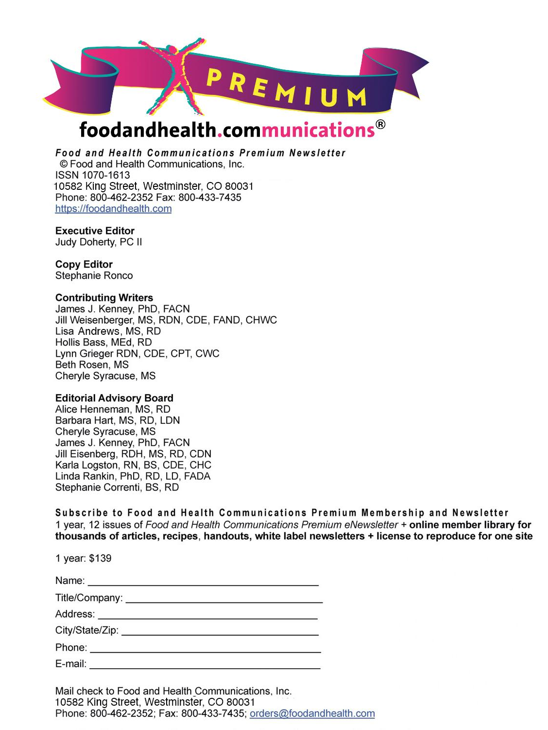
Lisa Andrews, MEd, RD, LD

