Slide 1
June 2023
Nutrition
NEWSLETTER
Inside:
Brought to you by:
Summer Farro Salad by Judy Doherty, MPS, PC II
Vegetarian Stuffed Peppers, by Judy Doherty, MPS, PC II
Functional Spotlight: Turmeric, Lynn Grieger, RDN, CDCES, CHWC, CPT
Healthy Gets a Reboot by Lisa Andrews, MEd, RD, LD
Healthy Gets a Reboot by Lisa Andrews, MEd, RD, LD
Mediterranean Diet Improves Mental Health, by Lisa Andrews, MEd, RD, LD
8 Foods for Mental Health, by Lisa Andrews, MEd, RD, LD
How to jumpstart your eating plan for less processed food by Lisa Andrews, MEd, RD, LD

Slide 2
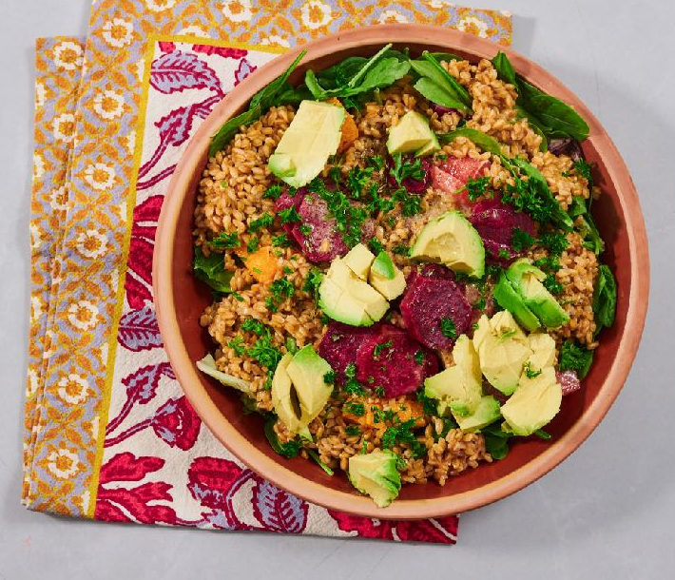
Summer Farro Salad
This delicious soup has a beautiful color from the turmeric.
Ingredients:
2 cups cooked farro, cooled
4 cups spring lettuce mix
1 avocado, peeled, pitted, diced
1 beet, peeled and sliced thin
1 scallion, sliced
1 cup sliced radishes
1 cup sliced cucumbers
Dressing:
Zest and juice of 2 lemons
Zest and juice of 1 orange
2 tablespoons olive oil
Salt and pepper to taste
1 tablespoon chopped parsley (optional)
Directions:
Prepare all of the ingredients.
Place the greens in the bottom of a large salad bowl.
Top with the cooked farro.
Pour the dressing over the top and toss slightly.
Add all of the veggies on the top.
Serve family style.
Serves 3-4. Each 1 cup serving: 365 calories, 19 g fat, 3 g saturated fat, 0 mg cholesterol, 125 mg sodium, 35 g carbohydrate, 10 g fiber, 6 g protein.

Slide 3
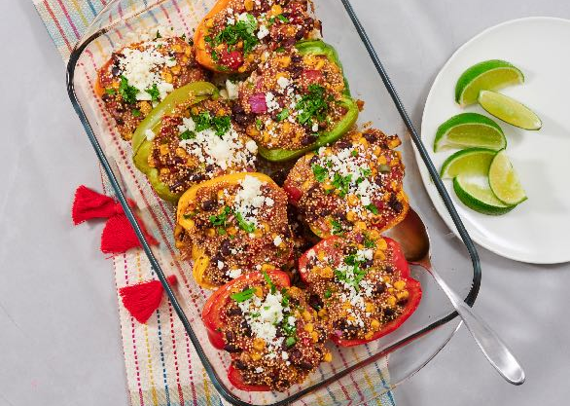
Vegetarian Stuffed Peppers
Ingredients:
Stuffed peppers:
1 tsp oil
1/2 cup diced red onion
2 cloves minced garlic
1 can black beans, low sodium, rinsed
1 cup cooked corn kernels (fresh or frozen)
1 cup diced tomatoes
1 tsp cumin
1 tsp chili powder
1 cup cooked quinoa
4 peppers, cut in half lengthwise and seeds removed
Garnish:
Chopped cilantro
1/4 cup feta cheese, crumbled
Limes
Directions:
Make the stuffing. Sauté the onion and garlic in oil in a large skillet. Add the beans, corn, seasonings, and tomatoes. Stir and heat. Add the quinoa. Stir well, then spoon the filling into pepper halves in a large rectangular baking dish. Cover the dish and bake for 40 minutes at 350 degrees or until the peppers are soft.
Garnish with chopped cilantro and crumbled cheese. Serve fresh lime wedges served on the side.
Nutrition Facts:
Serves 4. Each serving: 259 calories, 5 g fat, 2 g saturated fat, 8 mg cholesterol, 620 mg sodium, 43 g carbohydrates, 12 g fiber, 8 g sugar, 12 g protein

Slide 4
Functional Ingredient Spotlight: Turmeric
We choose what we eat for a variety of reasons: taste, convenience, cost, and health concerns. Food manufacturers capitalize on consumers’ desire for healthy foods by adding ingredients that are marketed to help protect our immune system, improve mood, and increase energy levels.
According to a market analysis report, these added ingredients, known as functional ingredients, are expected to grow by 6.4% annually over the next seven years. While whole foods like fruit, vegetables, and whole grains are essential for good health, today’s consumers are shifting toward fortified convenience foods and beverages that contain functional ingredients.
Three popular functional ingredients you’ll find in various foods and beverages are turmeric, collagen, and green coffee extract.
Let’s talk about turmeric…
Tumeric is a plant native to Southeast Asia, primarily India, where it is used as both a spice and also traditional medicine for skin disorders, joints, digestion, and upper respiratory tract issues. Curcumin is the primary component of turmeric that provides both the yellow color and the health benefits.
Snacks with turmeric or curcumin in the ingredient list accounted for 9% of all new turmeric product launches in both 2015 and 2019. Frozen breakfasts, microwaveable meals, and tea/juices are other popular foods to which food manufacturers add turmeric in order to boost consumer appeal.
Research shows that curcumin may reduce the risk of cardiovascular disease and diabetes by reducing inflammation and oxidative stress. There’s also some research that shows curcumin may help improve memory and mood by modulating serotonin and dopamine production. However, the amount of turmeric or curcumin used as a functional ingredient is typically much smaller than the dose used in research studies so there is no way of knowing if there is any health benefit.
Written By Lynn Grieger, RDN, CDCES, CHWC, CPT

Slide 5
Healthy Gets a Reboot
I recently found a yogurt listed as “no added sugar” that was $1 more per container than the usual plain Greek yogurt I purchase. After looking at the label, I realized the new (pricier) one was higher in fat and had the same amount of sugar as my usual version. How is this any better? I imagine consumers can get confused, too about what’s considered a healthier choice when comparing food labels.
The definition of “healthy” is getting a makeover by the US FDA. It will include nutritional parameters that a product has to meet to add the claim “healthy” to the package. In addition, the FDA is also doing research on a symbol to identify the claim “healthy”. The symbol and claim on the front of the package would provide consumers with a quick way to find foods that will empower them to move towards healthy dietary patterns.
Over 80% of individuals in the US don’t eat enough fruit, vegetables, or dairy products, based on the US Dietary Guidelines for America, 2020-2025. Additionally, many consumers eat excessive added sugars, saturated fat, and sodium. This is a big concern as poor dietary choices can raise the risk of several chronic conditions.
Susan Mayne, Ph.D., director of FDA’s Center for Food Safety and Applied Nutrition advises being mindful of food choices now and not waiting for the new definition to guide you.
“To make healthier food choices for yourself and your family, aim to eat a variety of vegetables, fruits, whole grains, lower-fat dairy products, protein foods, and healthy oils—like olive and canola,” Dr. Mayne says. “Try to eat and drink fewer foods and beverages high in saturated fat, sodium, or added sugars.”
Dr. Maybe also suggests using the Nutrition Facts label on food packages. Take a look at the Percent Daily Value, listed as %DV on the label. It lists the most important nutrients to focus on that either prevent disease (such as fiber, and potassium) or promote disease (such as sodium, and saturated fat).
The Word “Healthy” Gets a Makeover
“Healthy” got its start on food packages as a nutrient claim in 1994. At the time, it was based on federal dietary guidelines and nutrition science. Saturated fat, total fat, cholesterol, and sodium were the main focus in addition to certain vitamins and minerals, fiber, and protein. Upper and lower amounts for some were listed.
Nutrition science and federal US dietary guidelines have changed since then. We have a better comprehension of diet patterns and their impact on health. We acknowledge that people build dietary habits with food, which makes up a lot of nutrients, not individual ones.
In order to align with current nutrition science and dietary guidelines, the FDA proposes the claim “healthy” be defined as:
A food has to contain a certain amount of a food group like fruits, vegetables, grains, proteins, and dairy.
A food can’t contain too much saturated fat, sodium, or added sugars.
Recent changes made to the Nutrition Facts label are aligned with the proposed rule. The label now lists “added sugars” under total sugars to help people find healthier choices.
By Lisa Andrews, MEd, RD, LD

Slide 6
Healthy Gets a Reboot
The Way the “Healthy” Definition Would Work
Here are a few results of the proposed new definition for the claim “healthy.”
Foods like salmon, avocados, and olive oil, which do not qualify for use of the “healthy” claim under the current regulations would qualify under the proposed definition.
Foods like sweetened cereals and yogurt that exceed the amount of allowed added sugars would no longer qualify.
Plain, non-carbonated water and plain, carbonated water could be labeled “healthy” as well. Under the current regulation, water cannot be labeled “healthy.”
Shoppers will simply have to look for the claim “healthy” or other terms such as “healthier” or “healthiest” on food packages to recognize they’re buying items that meet the FDA’s definition of “healthy”.
Are There Potential Benefits?
The leading causes of death and disability in the US are heart disease, Type 2 diabetes, some cancers, and overweight and obesity, which are all related to diet and lifestyle. Minority groups are at a higher risk to develop these conditions. As an example, over 4 in 10 American adults have high blood pressure but the number jumps to nearly 6 in 10 in non-Hispanic African American adults.
Revamping the definition of “healthy” is a positive step towards giving the public information to assist them in making better food choices to reduce chronic diseases and improve health equity. In addition, updating the definition of “healthy” may encourage more nutritious foods in the market if some companies choose to produce new products or reformulate products to match the definition.
Consumers can make healthier choices by doing the following:
Choose foods in their whole form. An orange versus orange juice. Fruit instead of fruit snacks.
Include fresh, frozen, and canned fruits and vegetables in your diet. Frozen and canned offer convenience and longer shelf life.
Limit fast food, fried foods, and ultra-processed meat and snack foods. Cut out sugar-sweetened drinks and limit alcohol.
Go meatless for a few meals per week. Use beans and lentils in salads, soups, or main dishes.
Swap refined grains for whole grains including rolled oats, brown rice, whole wheat pasta, and other grains.
Use the 5 and 20% rule on labels. Choose ingredients with 5% or less of unwanted ingredients such as sugar, sodium, and saturated fat. Aim for foods containing 20% or more fiber, calcium, iron, and potassium.
Choose non-fat or low-fat dairy products when possible.
Include healthy fats in your diet from avocados, nuts, seeds, and plant-based oils.
FMI:
https://www.fda.gov/consumers/consumer-updates/fresh-take-what-healthy-means-foodpackages#:~:text=%E2%80%9CTo%20make%20healthier%20food%20choices,sodium%2C%20or%20added%20sugars.%E2%80%9D
By Lisa Andrews, MEd, RD, LD

Slide 7
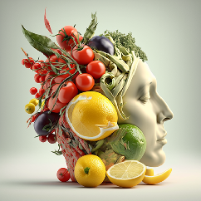
Mediterranean Diet for Better Mental Health
We’ve all experienced anxiety or depression at one time or another in our lives. According to the CDC, 11.7% of adults over 18 experience anxiety or worry regularly while 4.8% have feelings of depression. These numbers grew even higher during and after the pandemic. Estimates as high as 25% of adults have been recorded for the prevalence of anxiety.
Chronic worrying and stress may have long-term effects on your physical health. According to the American Psychological Association, constant anxiety and stress may raise your risk for cardiovascular disease, infertility, arthritis, and metabolic disorders such as diabetes and obesity.
A Western-style diet is considered more pro-inflammatory and may impact mental health. A meta-analysis of studies of 157,409 participants found that those in the highest inflammatory diet group had a significant association with the incidence of depression and anxiety. Those in the lowest inflammatory diet group experienced a lower risk for anxiety and depression.
The good news is that a Mediterranean-style diet may put you in a better state of mind. One study in over 150 adults with depression found that individuals attending a 3-month Med-diet cooking class along with the use of fish oil supplements had better fruit, vegetable, legume, nuts, and whole grain intake and reduced intake of red meat and unhealthy snacks. Depressive symptoms were kept at bay for 6 months after the intervention.
In addition, a randomized control trial in young men with depression (aged 18 to 25 years) also indicates that a Mediterranean-style diet may alleviate depressive symptoms. A 12-week intervention of a Mediterranean diet or “befriending” (control group), found better adherence to a Mediterranean diet and more change in the Beck Depression Inventory Scale. Quality of life scores was also higher in the Mediterranean group.
While vegetables, legumes, and whole grains are a big part of the Mediterranean diet, a vegetarian diet was not correlated with a reduced risk of depression, anxiety, or stress. A recent systematic review and meta-analysis of observational studies found no link between a vegetarian diet and depression or anxiety. Further research is needed in this area.
See list of references online.
By Lisa Andrews, MEd, RD, LD

Slide 8
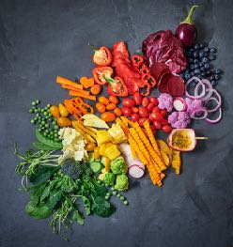
Top 8 Foods to Improve Mental Health
There are lots of great foods to consume to reduce the risk of depression. Here are the top 8:
Whole grains like rolled oats, brown rice, or whole wheat couscous. These provide complex carbohydrates as well as tryptophan, a neurotransmitter associated with good mood.
Add fruits and vegetables to all meals. Higher intakes of fruits and vegetables have been found to be beneficial in reducing the incidence of depression in middle-aged and older adults in a recent systematic review and meta-analysis. 8
Beans, including soybeans. Beans contain plenty of dietary fiber, which has been found to reduce the risk of depression. 9
Fatty fish. Salmon, tuna, and mackerel are sources of omega-3 fatty acids, a healthy fat linked with a reduction in inflammation. A meta-analysis of studies indicates that fish higher fish intake is linked with reduced rates of depression. 10
Leafy, green vegetables. Leafy greens provide the B vitamin folate. One study found that subjects with normal levels of folate and B12 (versus low levels) had lower rates of depression. 11
Nuts and seeds, especially walnuts. Walnuts are a plant source of omega-3 fatty acids. A recent study found that nut eaters had lower depression scores than non-nut eaters. The impact was strongest in women. 12
Yogurt and other fermented dairy foods. A recent meta-analysis of cohort studies indicated that fermented dairy intake was associated with lower rates of depression. The authors believe this is related to the gut-brain axis. 13
Extra virgin olive oil. It’s not just good for your heart. The use of EVOO was found to reduce symptoms of depression in those dealing with severe depression, but not mild to moderate depression. It certainly can’t hurt to use it in place of other oils. 14
By Lisa Andrews, MEd, RD, LD

Slide 9
How to Kick the Processed Food Habit
Lather, rinse, repeat. Sometimes poor eating habits become a vicious cycle. We’re anxious, disappointed, or sad about something so we “treat ourselves” to a bag of chips or a big candy bar.
We’re not really hungry, we’re just feeding an emotion. But that habit of grabbing processed food when we’re feeling blue may exacerbate those negative feelings, especially anxiety, and depression.
8 Steps to Better Eating:
Start your day with a solid meal, not a bar or fast food sandwich. Peanut butter on toast, Greek yogurt, cottage cheese with fruit, or a hard-boiled egg with crackers are good starters.
Keep seasonal fruits and veggies on hand and include at least one in each meal and snack.
Do Meatless Monday more often. Canned beans or lentils make quick meals when you’re in a hurry. Skip fast food when possible.
Take inventory of your pantry. How frequently do chips, cookies, or other processed snacks end up on the shelves?
Don’t shop when you’re hungry, upset, or stressed out. You’re more likely to pick up snacks or “comfort” foods.
Ignore coupons for boxed pasty mixes or other processed foods that you normally wouldn’t buy.
Get your ZZZs. Poor sleep raises cortisol levels, increasing cravings for salt, fat, and sugar. Aim for 7 to 8 hours per night.
Learn to deal with stress and anxiety in healthy ways. Exercise, meditate, journal, or seek a mental health professional if needed.
Lisa Andrews, MEd, RD, LD

Slide 10
Ultra-processed Problems
How to Kick the Processed Problem
Start your day with a solid meal, not a bar or fast food sandwich. Peanut butter on toast, Greek yogurt, cottage cheese with fruit, or a hard-boiled egg with crackers are good starters.
Keep seasonal fruits and veggies on hand and include at least one in each meal and snack.
Do Meatless Monday more often. Canned beans or lentils make quick meals when you’re in a hurry. Skip fast food when possible.
Take inventory of your pantry. How frequently do chips, cookies, or other processed snacks end up on the shelves?
Don’t shop when you’re hungry, upset, or stressed out. You’re more likely to pick up snacks or “comfort” foods.
Ignore coupons for boxed pasty mixes or other processed foods that you normally wouldn’t buy.
Get your ZZZs. Poor sleep raises cortisol levels, increasing cravings for salt, fat, and sugar. Aim for 7 to 8 hours per night.
Learn to deal with stress and anxiety in healthy ways. Exercise, meditate, journal, or seek a mental health professional if needed.
References:
USDA
Suksatan W, Moradi S, Naeini F, Bagheri R, Mohammadi H, Talebi S, Mehrabani S, Hojjati Kermani MA, Suzuki K. Ultra-Processed Food Consumption and Adult Mortality Risk: A Systematic Review and Dose-Response Meta-Analysis of 207,291 Participants. Nutrients. 2021 Dec 30;14(1):174. doi: 10.3390/nu14010174. PMID: 35011048; PMCID: PMC8747520.
Pagliai G, Dinu M, Madarena MP, Bonaccio M, Iacoviello L, Sofi F. Consumption of ultra-processed foods and health status: a systematic review and meta-analysis. Br J Nutr. 2021 Feb 14;125(3):308-318. doi: 10.1017/S0007114520002688. Epub 2020 Aug 14. PMID: 32792031; PMCID: PMC7844609.
Home | Dietary Guidelines for Americans
Bear TLK, Dalziel JE, Coad J, Roy NC, Butts CA, Gopal PK. The Role of the Gut Microbiota in Dietary Interventions for Depression and Anxiety. Adv Nutr. 2020 Jul 1;11(4):890-907. doi: 10.1093/advances/nmaa016. PMID: 32149335; PMCID: PMC7360462.
Godos J, Bonaccio M, Al-Qahtani WH, Marx W, Lane MM, Leggio GM, Grosso G. Ultra-Processed Food Consumption and Depressive Symptoms in a Mediterranean Cohort. Nutrients. 2023 Jan 18;15(3):504. doi: 10.3390/nu15030504. PMID: 36771211; PMCID: PMC9919031.
Lane MM, Gamage E, Travica N, Dissanayaka T, Ashtree DN, Gauci S, Lotfaliany M, O'Neil A, Jacka FN, Marx W. Ultra-Processed Food Consumption and Mental Health: A Systematic Review and Meta-Analysis of Observational Studies. Nutrients. 2022 Jun 21;14(13):2568. doi: 10.3390/nu14132568. PMID: 35807749; PMCID: PMC9268228.
Yang CL, Schnepp J, Tucker RM. Increased Hunger, Food Cravings, Food Reward, and Portion Size Selection after Sleep Curtailment in Women Without Obesity. Nutrients. 2019 Mar 19;11(3):663. doi: 10.3390/nu11030663. PMID: 30893841; PMCID: PMC6470707.
Lisa Andrews, MEd, RD, LD

Slide 11
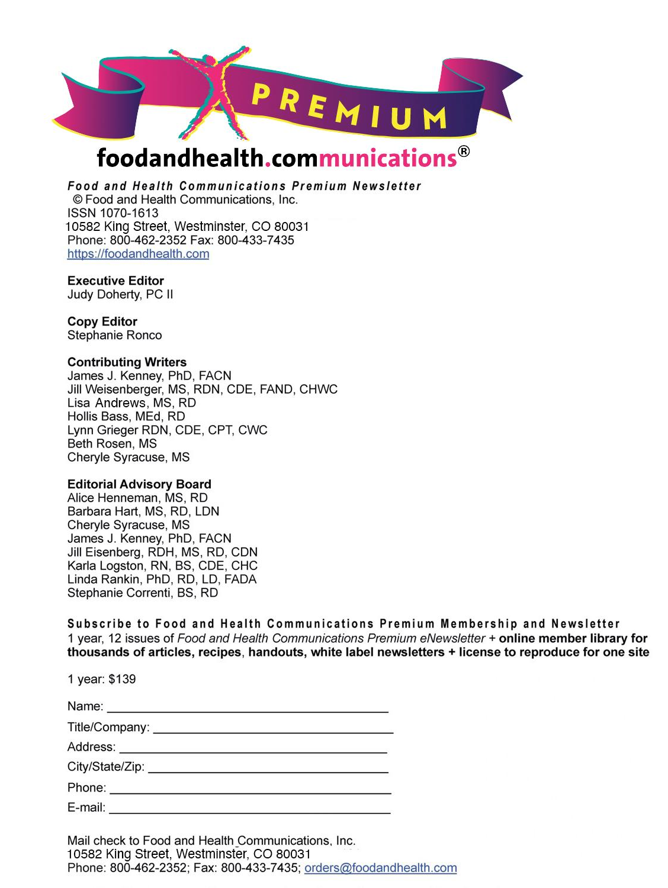
Lisa Andrews, MEd, RD, LD

