Slide 1
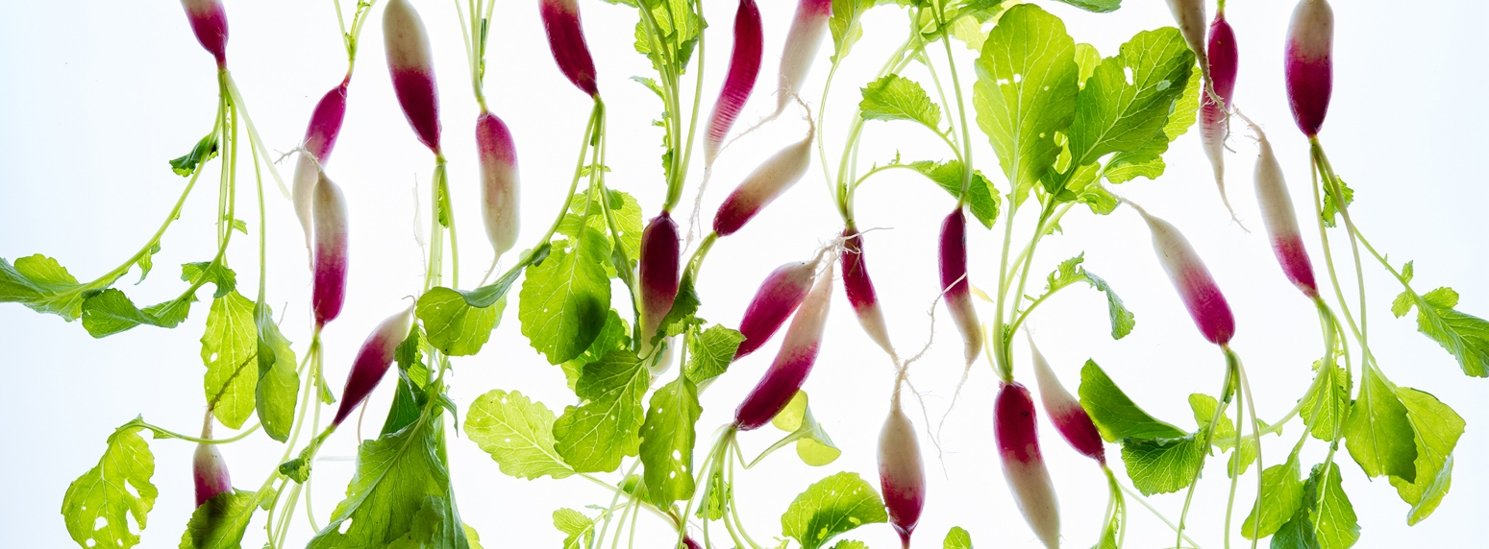
Date
My Nutrition
NEWSLETTER
In This Issue:
2. Sautéed Spinach Salad, by Judy Doherty, BS, PC II
3. Pistachio Kale Salad, by Judy Doherty, BS, PC II
4. COVID-19 Nutrition 101 by Lisa Andrews, MEd, RD, LD
6. Overnight Oats by Cheryle Jones Syracuse, MS
7. Heart Disease Update, Lynn Greiger, RD, LD, CWEH
8. Let’s Compare Some Cheese
Brought to you by:

Slide 2
Spinach Sautéed Salad
Ingredients:
2 fresh plum or heirloom tomatoes, seeded and diced
2 garlic cloves
olive oil spray
1 bunch fresh spinach leaves, rinsed and dried
fresh basil leaves
black pepper to taste
1 tablespoon red wine vinegar
Directions:
Prepare all ingredients as described above.
Heat a large nonstick saute pan over medium heat. Saute the tomatoes and garlic lightly until the garlic is soft. Add the spinach and basil leaves and cover the pan for 2 minutes. Stir lightly.
Serve the spinach warm on a plate. It can be a vegetable side dish or a warm salad. It goes great over pasta or rice.
Chef's Tips:
You can use this spinach dish with baked fish or grilled seafood. Use it as a warm and delicious side dish!
Nutrition Facts:
Serves 4. Each 1 cup serving: 44 calories, 2g fat, 0g saturated fat, 0g trans fat, 0mg cholesterol, 71mg sodium, 6g carbohydrate, 3g fiber, 2g sugars, 3g protein.

Slide 3
Pistachio Kale Salad
This spring salad is so delicious. The leaves are warmed in a sauté pan and the salad is served with crunch pistachios. It is a perfect dish for spring and early summer.
Ingredients:
6 cups of fresh curly kale leaves, rinsed, dried, ready to serve
1/2 cup sliced green onion
1/4 cup pistachio nuts, chopped
olive oil spray
balsamic vinegar glaze
Directions:
Heat a sauté pan over medium heat. Spray with olive oil spray. Lightly sauté the kale leaves until they turn a bright green. Remove from the pan. Sauté the onion and pistachios until they turn a little brown. Add the kale and toss together.
Turn the salad out onto a plate. Sprinkle with balsamic vinegar glaze.
Chef's Tips:
Feel free to use any type of flavored vinegar in place of the balsamic syrup. Serve warm.
Nutrition Facts:
Serves 4. Each 1 cup serving: 99 calories, 4g fat, 1g saturated fat, 0g trans fat, 0mg cholesterol, 46mg sodium, 13g carbohydrate, 3g fiber, 2g sugars, 5g protein.

Slide 4
Overnight Oats
What are overnight oats?
Oatmeal has always been a hot topic when it comes to nutrition. One of the latest crazes is actually “cold” oatmeal, otherwise known as overnight oatmeal or overnight oats. This really isn’t something new, it’s just a resurgence of a classic with a new name. Have you ever heard of muesli? This was the original overnight oatmeal!
The story goes that muesli was developed by a Swiss doctor for his patients back in the early 1900s. Originally, it was a diet food and served as an evening meal, but it has evolved into a breakfast food that is usually prepared the night before so that it is ready to eat cold in the morning. Overnight oatmeal is simply uncooked oatmeal mixed with other ingredients -- usually milk or fruit juice and fresh fruits, raisins, grains, and/or nuts that then all come together in the refrigerator overnight.
How do you make them?
There are many packaged varieties of muesli available in grocery and specialty stores. One version has fruit already mixed with the oatmeal and you simply add your milk or other liquid to the container and put it in the refrigerator. Be sure to read the ingredients labels on these products for added ingredients that you may not want.
For a less expensive (and more creative) way to make your own muesli, you can try a base recipe like this one and then vary the ingredients based on your personal preferences or what’s in your cupboard/refrigerator at the time.
Oats, half cup
Skim milk, to wet the oats
Yogurt, half cup to make it creamy
Fresh fruit, one cup
Nuts, just a sprinkle!
Mix, chill for at least an hour or overnight, serve
Makes a great breakfast or dessert!
Overnight oatmeal can be a great ready-to-go nutritious breakfast. In a typical bowl, you get 4 grams of dietary fiber, 5 grams of protein, and only 3 grams of fat when you start with just a ½ cup of uncooked rolled oats. Then add your milk, fruits, and nuts for additional nutrition bonus.

Slide 5
5 Ways to Reduce Heart Disease
The American Heart Association (AHA) and the American College of Cardiology (ACC) have released updated guidelines on the important role of lifestyle choices in reducing cardiovascular risk.
The report details 5 ways to reduce cardiovascular disease:
Healthy food choices
Regular exercise
Do not use tobacco products, including e-cigarettes
Talk with your doctor about factors that affect your health, such as housing, food security, transportation, self-image, and culture
Talk with your doctor about whether aspirin for prevention is right for you
The scientific research clearly shows that routinely choosing foods that are high in animal fat and protein, low in fiber, and high in added sugars and processed foods are associated with increased cardiac risk.
Emphasize plant-based foods such as vegetables, fruits, legumes (dried beans and peas such as lentils, chickpeas, kidney beans, black beans, and pinto beans), nuts, and whole grains.
These foods are high in fiber and low in saturated fat and cholesterol, and a plant-based, Mediterranean style diet lowers cardiovascular risk compared to other types of eating patterns.
Fill half your plate with vegetables or fruit at meals.
Add legumes like chickpeas or pinto beans to salads, or choose legume-based soups like lentil, black bean, or vegetarian chili.
Sprinkle nuts on oatmeal, in yogurt, or on salads.
Choose whole grain breads, cereals and crackers; brown rice, and whole grain pasta.
Choosing more lean protein foods such as fish or skinless chicken and turkey while eating less red meat and processed meats such as sausage, bacon, and lunch meats that are high in harmful saturated fat and sodium.
Here are some ways to choose more lean protein...
Cook chicken or turkey with the skin on, and then remove the skin before eating to enjoy flavorful and moist meat with less harmful saturated fat.
Choose baked, broiled or grilled fish instead of seafood that is breaded and fried.
Replace lunchmeats with nut butter or slice your own roasted chicken or turkey.
Enjoy more foods that are less processed to reduce sodium, trans fat, and saturated fat.
By Lynn Grieger, RDN, CDE, CPT, CHWC
Death rate much higher than Covid-19
According to the latest statistics from the AHA, heart disease and stroke are the leading causes of death in the United States, responsible for an estimated 840,678 deaths each year – about 1 out of every 3. The focus of the guidelines is prevention of heart attack, angina, stroke, peripheral arterial disease, heart failure, and atrial fibrillation. The report clearly states that the most important way to prevent cardiovascular disease is through a healthy lifestyle. According to Donna Arnett, co-chair of the 18-person guidelines writing committee, making lifestyle changes before adding medication is important, because our daily food choices and exercise habits have a direct influence on cardiovascular health.

Slide 6
Let’s Compare Cheese
.
During our research, we found more than a few surprises about some of our favorite cheeses. For example, the sodium content of Parmesan cheese was truly shocking -- 330 mg of sodium in a single ounce! American cheese and the vegan cheese alternative were also surprisingly high in sodium. Saturated fat, another another food element that we're always looking to reduce, also had some revelations for us. American cheese had the most saturated fat, while mozzarella, the reduced-fat cheeses, goat cheese, and the vegan cheese alternative all had the least. In terms of total fat, all those same cheeses had the least, while American once again had the most.
Now let's explore the nutrients we do want. Swiss cheese had the most calcium in a single serving, while goat cheese had the least. And parmesan was a protein powerhouse, followed closely by Swiss, while the vegan cheese alternative had no protein at all.
What do you think of these results? Did any cheeses stand out to you?
A few notes about our samples: We compared the store brand of all cheeses, when possible. Each serving size was one ounce. The vegan cheese alternative was Dairy Free Mozzarella Shreds by Follow Your Heart.

