Slide 1
May 2024
Nutrition
NEWSLETTER
Inside:
Brought to you by:
Black Bean Taco Salad
Summer Cobb Salad
Moderate Physical Activity Reduces Childhood Obesity
Light Physical Activity 101
Summer MyPlate
Build A Higher Fiber Salad
7 Fast Healthy Meals

Slide 2
High Fiber Salad
Here is a fun twist on a taco and a salad with the combination of both together!
Black Bean Taco Salad
INGREDIENTS
2 small corn tortillas
1/4 cup black beans, drained and heated
1 tablespoon shredded Jack cheese
1 tomato, cored and diced
1 cup lettuce, rinsed and sliced
1 tablespoon diced red onion
1 tablespoon nonfat plain yogurt
1 tablespoon guacamole
INSTRUCTIONS
Place the heated beans on the tortillas followed by the cheese and heat in the microwave for 30 seconds or until the cheese just melts.
Top with the rest of the ingredients as pictured.
Add a little dressing or oil and vinegar to the lettuce.
Enjoy!
Chef's Tips: Mashed avocado makes a great stand-in for guacamole if you don't have time to make it or can't find it prepared.
Serves 1. Each 2 cup serving: 168 calories, 6 g fat, 2 g saturated fat, 9 mg cholesterol, 0 mg trans fat, 90 mg sodium, 21 g carbohydrates, 7 g fiber, 6 g sugar, 9 g protein.

Slide 3
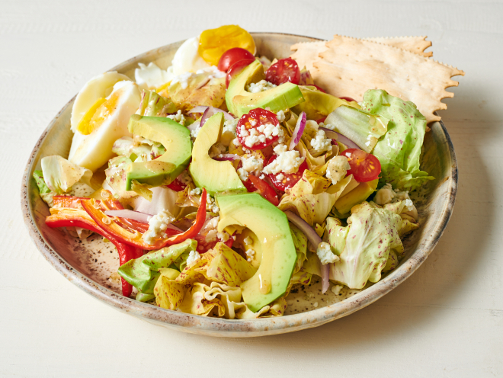
High Fiber Salad
Summer Cobb Salad
Ingredients:
4 cups bibb lettuce, cut, rinsed, spun dry
2 cups cherry tomatoes, remove stem and cut in half
1 tablespoon blue cheese crumbles
1 avocado, peeled, cored, and cut into slices
4 eggs, hardboiled, peeled, cut in half
1/2 red onion, sliced thin
1 red pepper, cut into strips
Directions:
Prepare all the ingredients. Chill until ready to assemble.
To assemble, toss the lettuce in vinaigrette. Place on a plate. Top with all the ingredients. Serve immediately.
Chef's Tips: We opted to omit the bacon bits and use more avocado than the traditional Cobb salad. The lettuce here is cranberry bibb lettuce but any bibb or green lettuce will do.
Serves 4. Each 2 cup serving: 185 calories, 12 g fat, 2 g saturated fat, 165 mg cholesterol., 0 g trans fat, 98 mg sodium, 11 g carbohydrate, 5 g fiber, 9 g protein.

Slide 4
Reversing Childhood Obesity Through Light Exercise
Being a couch potato in your younger years is directly related to childhood obesity, but a new study shows that light exercise may totally undo this chronic disease.
The study was completed as a collaboration between University of Exeter, University of Eastern Finland, University of Bristol, and University of Colorado and recently published in Nature Communications.
The research is one of the biggest and longest follow-up studies to monitor physical activity and fat mass. It utilized the University of Bristol's Children of the 90s data (also known as the Avon Longitudinal Study of Parents and Children. Over 6,050 children (53% girls) aged 11 years that were monitored until they turned 24.
Recent studies suggest that over 80% of teenagers globally don’t meet the World Health Organizations’ (WHO) advised average of one hour per day of moderate to vigorous physical activity.
It’s predicted that being sedentary will have caused 500 million new cases of diabetes, heart disease, obesity or other noncommunicable chronic disease by 2030 which annually costs 21 million.
This scary statistic regarding sedentary lifestyle requires urgent research on the most effective prevention.
However, results of this recent study find that moderate-to-vigorous exercise is up to ten times less effective than light physical activity in reducing overall fat mass gain.
Moderate-to-vigorous physical activity was fairly stable at 50 minutes per day from childhood to young adulthood while light exercise decreased from six hours per day to three hours daily.
For each minute spent being sedentary, a 1.3 gram increase in total body fat mass was observed. Male and female children both picked up an average of 10 kg of fat mass through growth from childhood to early adulthood.
Written By Lisa Andrews, MEd, RD, LD

Slide 5
Light Physical Activity 101
Light physical activity refers to any movement that expends energy but doesn't significantly raise your heart rate or cause you to break a sweat. Examples of light physical activity include:
Household Chores: Activities like sweeping, dusting, vacuuming, washing dishes, and light gardening can all contribute to light physical activity.
Active Transport: Choosing active modes of transportation such as cycling, walking, or using stairs instead of elevators or escalators.
Yard Work: Light gardening tasks like watering plants, weeding, or planting flowers can provide gentle exercise.
Stretching: Gentle stretching exercises or yoga can help improve flexibility, reduce stiffness, and promote relaxation.
Standing: Spending time standing instead of sitting can also be considered light physical activity. For example, standing while talking on the phone or while waiting in line.
Playing with Children or Pets: Engaging in light play activities with children or pets, such as playing fetch, tag, or tossing a ball around.
Casual Sports: Participating in low-intensity recreational activities like mini-golf, leisurely cycling, or casual swimming.
Here are some tips to increase physical activity in children throughout their lifespan:
Be a role model. Limit your screen time and participate in walking, jogging, or other light activity. Limit your children’s screen time. Using a screen or watching TV often are sedentary behaviors.
Schedule play time with family. Kick a ball in your yard or go for a family hike. Take a tumbling class with your toddler. Go for a family bike ride when the weather is nice.
Find a family-friendly gym or recreation center in your neighborhood.
Encourage children to join a sports team or league so they have regular physical activity built in.
Join a neighborhood pool in the summer.
Use a DVD or YouTube video for indoor exercise in colder months
Praise children for being active, but don’t reward them with food.
Written By Lisa Andrews, MEd, RD, LD

Slide 6
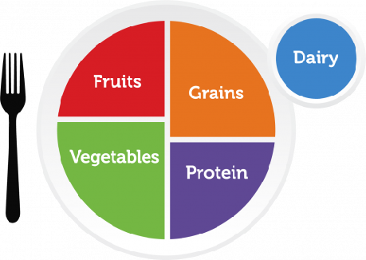
MyPlate: Get Ready for Summer
Adapting MyPlate guidelines for summer helps you make the most of seasonal produce and maintain a balanced diet. Here's how you can enjoy MyPlate recommendations for the summer months:
Fruits and Vegetables: Take advantage of the abundance of fresh fruits and vegetables available during the summer. Aim to fill half of your plate with a variety of colorful fruits and vegetables. Choose options like berries, melons, tomatoes, cucumbers, peppers, corn, zucchini, and leafy greens. Enjoy them raw in salads, as snacks, or grilled for added flavor. By visiting a farmer’s market you can be more aware of fresh, local seasonal produce while getting great prices and meeting the people who grow your food.
Grains: Incorporate whole grains into your meals for sustained energy. Choose whole grain options like whole wheat bread, brown rice, quinoa, barley, or whole grain pasta. These grains provide fiber, vitamins, and minerals to support overall health. Try incorporating whole grains into chilled salads, side dishes, or as a base for grain bowls.
Protein: Include lean protein sources in your meals to support muscle health and satiety. Opt for grilled chicken, fish, tofu, tempeh, beans, lentils, or legumes. Grilling is a popular cooking method during the summer and can add delicious flavor to your protein choices. Consider making kabobs with vegetables and lean meats for a balanced meal.
Dairy or Dairy Alternatives: Choose low-fat or fat-free dairy options or dairy alternatives fortified with calcium and vitamin D. Enjoy yogurt parfaits with fresh fruits, smoothies with Greek yogurt, or calcium-fortified plant-based milk in your cereal or as a beverage.
Healthy Fats: Incorporate healthy fats into your diet for heart health and satiety. Add avocado slices to salads or sandwiches, drizzle olive oil over grilled vegetables, or include nuts and seeds in your snacks or meals. Remember to practice portion control, as fats are calorie-dense.
Hydration: Stay hydrated by drinking plenty of water, especially in hot weather. Choose milk or water as your primary beverage. Limit sugary drinks and alcohol, as they can contribute to dehydration and excess calorie intake.
Movement: It is also a time to enjoy physical activity like walking outside.
Enjoy a wide variety of foods from all food groups in moderation. Summer is a great time to experiment with new recipes and flavors using seasonal ingredients.

Slide 7
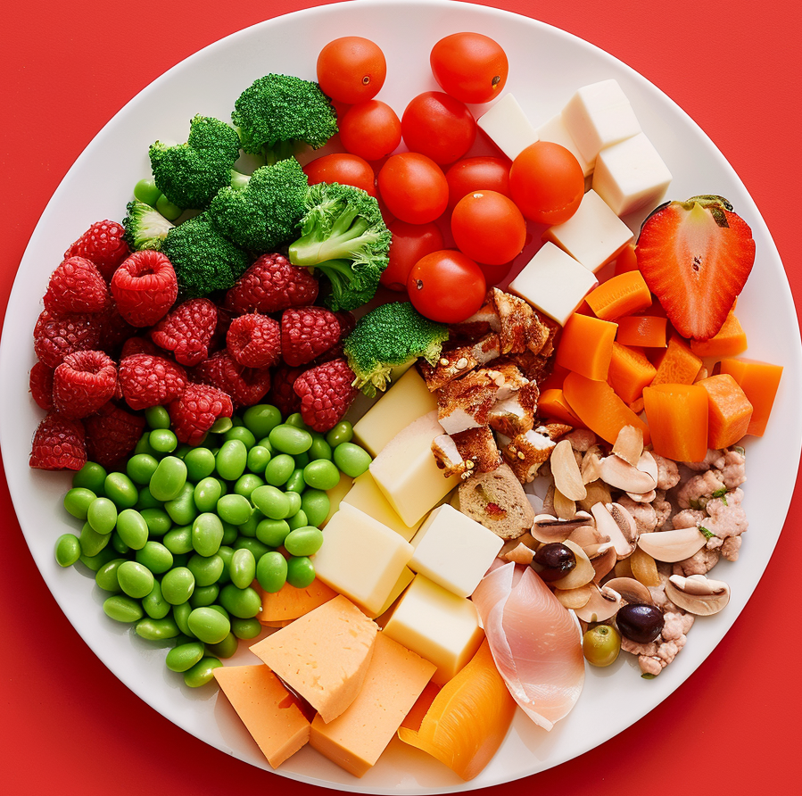
Build Higher-Fiber Salads
Creating a high-fiber salad is easy and delicious! Here are some of the highest fiber salad ingredients you can include:
1. Leafy Greens: Start with a base of dark leafy greens like spinach, kale, arugula, or mixed salad greens. These are low in calories and high in fiber.
2. Vegetables: Load up your salad with fiber-rich vegetables such as:
- Bell peppers
- Tomatoes
- Carrots
- Broccoli and cauliflower
- Radishes
- Zucchini
- Cabbage
3. Legumes and Beans: Add cooked beans or legumes for an extra boost of fiber and protein. Popular salad options include:
- Chickpeas
- Black beans
- Kidney beans
- Lentils
- Edamame
4. Whole Grains: Incorporate cooked whole grains into your salad for added texture and fiber. Options include:
- Quinoa
- Brown rice
- Farro
- Bulgur
- Wheat berries
5. Seeds and Nuts: Sprinkle seeds and nuts on top of your salad to add crunch, flavor, and additional fiber. Try:
- Chia seeds
- Flaxseeds
- Sunflower seeds
- Pumpkin seeds
- Almonds
- Walnuts
- Pecans
6. Fruits: While fruits are not typically associated with salads, adding some can bring a sweet and refreshing touch while contributing fiber. Consider:
- Berries (strawberries, blueberries, raspberries)
- Apple or pear slices
- Dried fruits
- Grapes
- Orange segments
- Avocado
By combining many of these ingredients, you can create a variety of delicious and nutritious salad packed with fiber to support your digestive health and overall well-being.

Slide 8
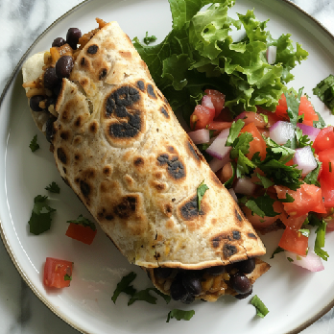
7 Of The Fastest Healthy Dinners
When you're short on time but still want a healthy dinner, opting for quick and nutritious recipes is the way to go. Here are some ideas for the fastest healthy dinners from our test kitchen:
Protein and Veggie Foil Pocket Dinner: Place fish or chicken fillets on a aluminum foil, add your favorite vegetables like bell peppers, zucchini, and cherry tomatoes, season with herbs, lemon juice, and a drizzle of olive oil. Seal the foil to create a packet and bake or grill for about 15-20 minutes until the fish or chicken is cooked through and vegetables are tender.
Stir-Fry: Stir-fries are quick and easy to make. Simply sauté your choice of lean protein (such as chicken, tofu, or shrimp) with vegetables (like broccoli, bell peppers, snap peas, and carrots) in a hot pan with a bit of oil. Season with soy sauce, garlic, ginger, and a sprinkle of sesame seeds. Serve over brown rice or quinoa for a complete meal.
Vegetable Omelette: Whip up a vegetable omelette with eggs and your favorite veggies such as spinach, mushrooms, onions, and bell peppers. Add a sprinkle of herbs for extra flavor and serve with whole grain toast or a side salad.
Grain Bowl: Cook quinoa or brown rice according to package instructions and let it cool. Toss cooked quinoa with chopped vegetables (cucumbers, cherry tomatoes, bell peppers, etc.), beans (such as black beans or chickpeas), herbs, a squeeze of lemon juice, and a drizzle of olive oil. Top with feta cheese or avocado for extra flavor.
Tuna or Chickpea Salad: Mix canned tuna or chickpeas with diced celery, red onion, and a dollop of Greek yogurt or mayonnaise. Season with salt, pepper, and a squeeze of lemon juice. Serve over mixed greens or whole grain bread for a quick and satisfying meal.
Pasta Primavera: Cook whole wheat pasta according to package instructions. In a separate pan, sauté a mix of vegetables such as cherry tomatoes, zucchini, bell peppers, and broccoli in olive oil with garlic and herbs. Toss cooked pasta with the vegetables, a splash of pasta water, and a sprinkle of Parmesan cheese.
Burrito Bowl: Assemble a quick burrito bowl with cooked brown rice or quinoa, black beans, sautéed peppers and onions, salsa, avocado slices, and a dollop of Greek yogurt or sour cream. Customize with your favorite toppings and enjoy a nutritious and satisfying meal in minutes.
These are just a few ideas for fast and healthy dinners. Remember to keep your kitchen stocked with staple ingredients like eggs, tuna, frozen lean protein, salad, canned beans, whole grains, and frozen vegetables to make meal preparation even quicker.

